Slide 1
Microkernel

Slide 2
What is microkernel?
a Microkernel (also known as μ-kernel) is the near-minimum amount of software that can provide the mechanisms needed to implement an operating system(OS). These mechanisms include low-level address space management, thread management, and inter-process communication (IPC).

Slide 3
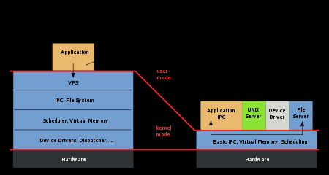
Monolithic and Microkernel

Slide 4
Microkernel
The kernel is composed of separate processes, known as servers.
Some of the servers run in kernel space and some run in user-space.
All servers are kept separate and run in different address spaces.
The communication in microkernels is done via message passing.

Slide 5
Microkernel..
The servers communicate through InterProcess Communication IPC.
Servers invoke “services” from each other by sending messages.
Advantage is this that if one server fails, other servers can still work efficiently.
Examples are Mac OS X and Windows NT.

Slide 6
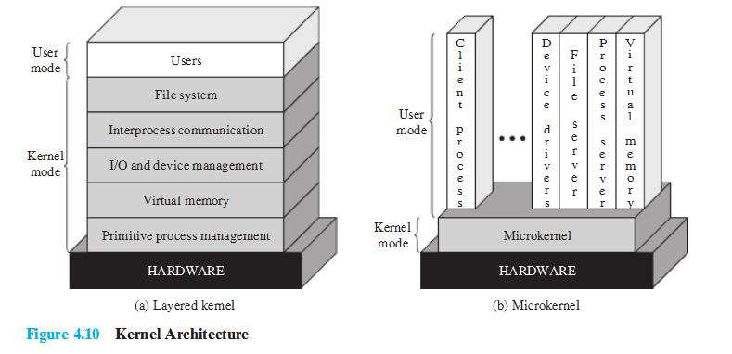
Architecture

Slide 7
Functioning
Absolutely essential core OS functions should be in the kernel, less essential services and applications are built on the microkernel and executed in user mode.
Many services that traditionally have been part of the OS are now external subsystems that interact with the kernel and with each other
These include device drivers, file systems, virtual memory manager, security system, and so on.

Slide 8
Functioning ..
The microkernel functions as a message exchange.
It validates messages, passes them between components and grants access to the hardware.
It also prevents message passing unless exchange is allowed.

Slide 9
Benefits
USER INTERFACES: The kernel level services and the user level services have a uniform interface for processes which use their services by means of message
passing.
EXTENSIBILTY: New services can be added.
FLEXIBILTY: Services can be subtracted or modified.

Slide 10
Benefits..
PORTABILITY: All or at least much of the processor specific code is in the microkernel. So the changes needed to port the system to a new processor are fewer and are arranged in logical groupings.
RELIABLITY: Smaller kernel makes its implementation likely to be more reliable.

Slide 11
Benefits..
DISTRIBUTED SYSTEM SUPPORT: A process can send a message without knowing on which computer the target service resides. Pieces can be on another machine.

Slide 12
Object Oriented OS
An object-oriented approach can lend discipline to the design of microkernel.
One promising approach is the use of components.
Components are objects with clearly defined interfaces that can be interconnected to form software in a building block fashion.
All interaction between components uses the component interface.

Slide 13
Disadvantages
A potential disadvantage of microkernel is its performance.
It takes longer to build and send a message via the microkernel, and accept and decode the reply, than to make a single service call.

Slide 14
What can be done?
So microkernel may be enlarged.
It may improve the performance but would affect design strengths i.e. minimal interfaces, flexibility and reliability.
Another approach is to make microkernel smaller. This improves performance as well as flexibility and reliability.

Slide 15
Design
The microkernel must include those functions needed to support the services and applications operating in user mode.
These functions fall into the general categories of low-level memory management, interprocess communication (IPC), and I/O interrupt management.

Slide 16
Design
The microkernel controls the hardware concept of address space to make it possible to implement at the process level.
A virtual memory module outside the microkernel decides when to bring a page into memory and which page already in memory is to be replaced
The microkernel maps these page references into a physical address in main memory.

Slide 17
Design
The basic form of communication between processes or threads in microkernel operating system is messages.
A message includes a header that identifies the sending and receiving process and a body that contains direct data, a pointer to a block of data, or some control information about the process.

Slide 18
Design
It is possible to handle interrupt as messages and to include I/O ports in address spaces.

Slide 19
Summary
Microkernel has separate processes known as servers.
Some run in kernel space and some run in user space.
The user mode is an external subsystem which includes services such as device drivers file systems, virtual memory manager, windowing system, and security system.
The essential OS functions are included in kernel mode where as the less efficient are built in microkernel but executed in user mode.

Slide 20
Summary
Communication between the processes is done via message passing.
Message passing can be done within a mode with each other or with processes residing in the other mode.
Microkernel’s performance is not good because message passing takes a lot of time.
Microkernel uses a virtual memory.
Handles interrupts as messages and includes I/O ports in address space.

Slide 21
Acknowlegement
https://www.slideshare.net/ReemaKhan3/microkernel-architecture
https://en.wikipedia.org/wiki/Microkernel

